Slide 1




Cyber-Enabled Wireless Monitoring Systems for the Protection of Deteriorating National Infrastructure Systems: Distributed In-Network Computation
Mingyan Liu
Electrical Engineering and Computer Science, UM
NIST Technology Innovation Program Y1 Annual Meeting
University of Michigan, Ann Arbor, MI
July 7-8, 2010
Prospect
Solutions, LLC

Slide 2
Computation over a network of sensors
In addition to sending raw data, can also perform in-network processing and send processed data:
Sensor i collects a data stream x_{i}
Need to compute f(x₁ , … x_{i} , … x_{n})
Can either have each sensor send x_{i} to the base station (or central server), or perform the computation in-network and deliver only f()
Pro: can potentially significantly reduce the amount of data transmitted, thereby conserve energy
Con: may need to approximate; also need to control overhead
Essence: feature extraction vs. data collection
Demonstrate these ideas using the example of SVD
Optimal design of communication and computation structures
Implementation on the Narada sensor platform

Slide 3
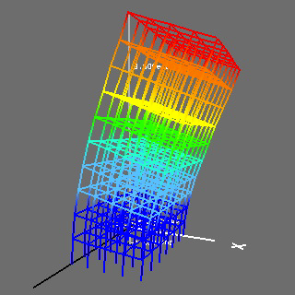
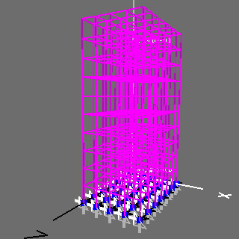
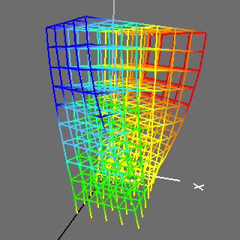
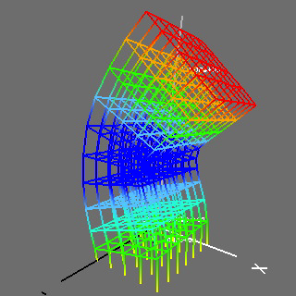
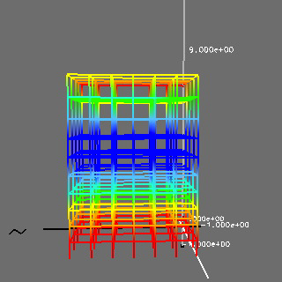
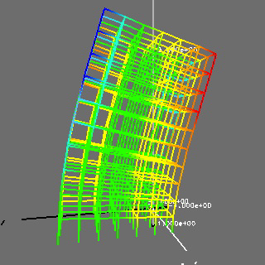
In-network structural health monitoring
Singular Value Decomposition (SVD):
Output-only modal analysis under free vibration
One of the most common computational needs
Generates the mode shapes of a structure

Slide 4
Centralized vs. distributed SVD
0
1
5
6
FFT
FFT
FFT
FFT
F₀(jω)
F₁(jω)
F₅(jω)
F₆(jω)
SVD
{φ₀ ,φ₁ ,φ₂ ,φ₃ ,φ₄ ,φ₅ ,φ₆}
0
1
2
3
4
5
6
FFT
FFT
FFT
FFT
FFT
FFT
FFT
F₀(jω)
F₁(jω)
F₂(jω)
F₃(jω)
F₄(jω)
F₅(jω)
F₆(jω)
B/S
SVD
SVD
SVD
{φ₀ ,φ₁ ,φ₄}
{φ₁ ,φ₂ ,φ₃}
{φ₄ ,φ₅ ,φ₆}
Scale and Combine
{φ₀ ,φ₁ ,φ₂ ,φ₃ ,φ₄ ,φ₅ ,φ₆}
[Lynch et al, 2006]

Slide 5
Optimal communication structure
Placement of operators:
Need to determine on which nodes SVD is performed
For each such node, determined the subset of nodes whose FFT it should collect
Goal is to minimize the total energy consumption with possibly a computational delay constraint
Summary of results:
Formulated as an integer linear program (ILP)
Hardness analysis
Without delay constraint, optimal solution given by a min. nonleaf-node data collection tree
With delay constraint, optimal solution well approximated (with proven approx. ratio) by a degree-constrained data collection tree
Designed distributed algorithms
6
5
4
3
2
1
0
SVD

Slide 6
Implementation and generalization
Have implemented distributed algorithms on the Narada sensor platform:
Automatic data collection tree construction
Currently testing construction delay as well as stability of the tree over a network of 20 nodes
Moving forward:
Will seek to generalize this framework:
Functional decomposition followed by operator placement over a graph
Tradeoff between accuracy and energy efficiency
How to automate this process
Other interesting examples: parallel simulated annealing
6
5
4
3
2
1
0
SVD

